Slide 1

SUPERIOR UNIVERSITY
SOCIAL MEDIA
NETWORKING SYSTEM
CONNECTING ALL OF US WITH THE WORLD

Slide 2
GROUP MEMBERS
SUPERIOR UNIVERSITY
GROUP NO. 1
Zunaisha Noor BIET-F21-049
Usmana Zulfiqar BIET-F21-013
Manahil Tehseen BIET-F21-067
Zoha Mahmood BIET-F21-017

Slide 3
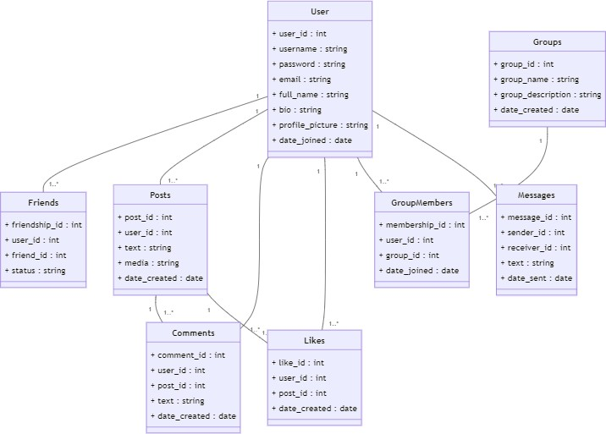
PHYSICAL DESIGN

Slide 4
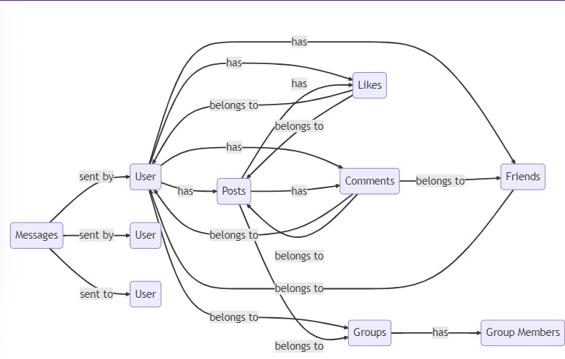
LOGICAL DESIGN

Slide 5
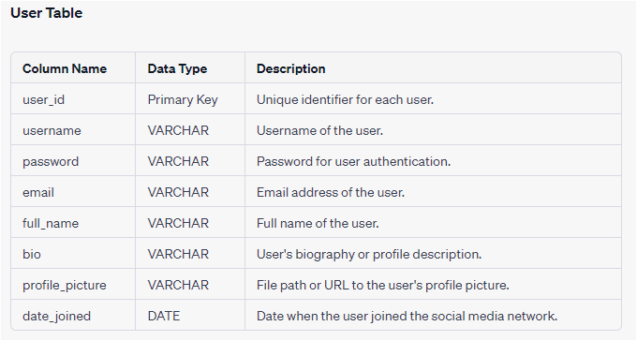
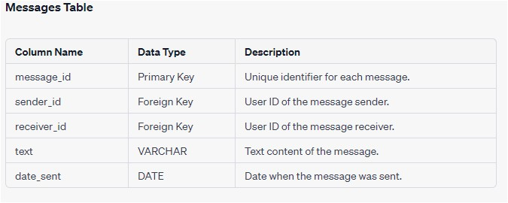
DATA DICTIONARY

Slide 6
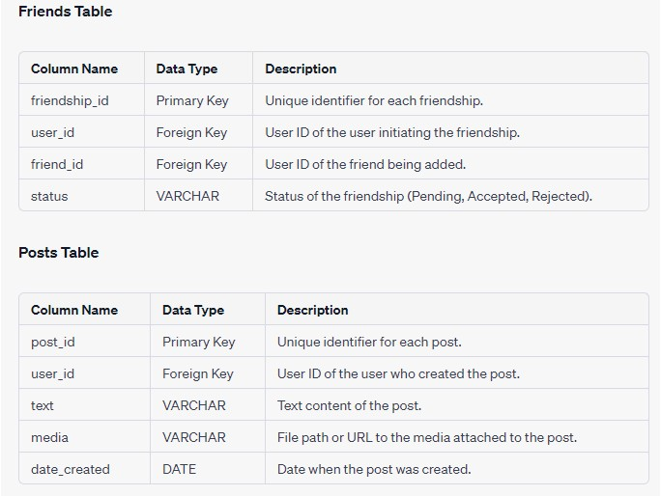
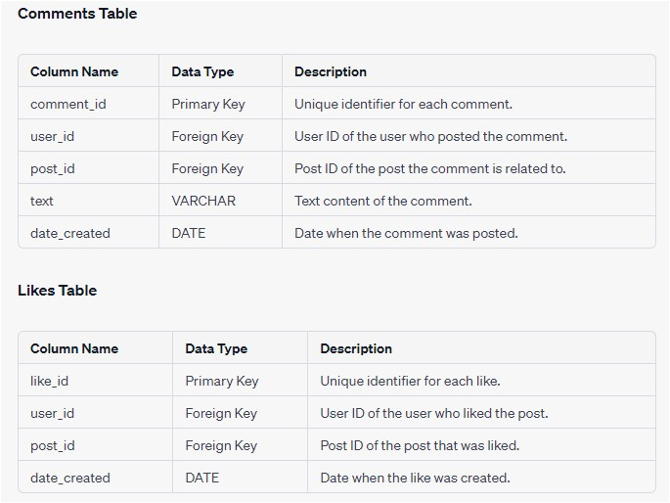
DATA DICTIONARY
Comments Table

Slide 7
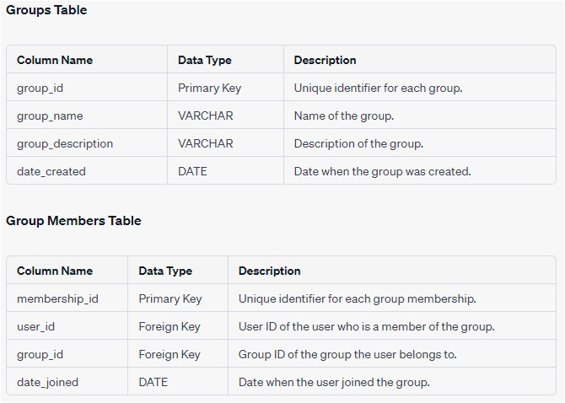
DATA DICTIONARY

Slide 8
QUERIES APPLIED
C R E A T E U P D A T E D E L E T E D R O P
S E L E C T J O I N
L O C K A L T E R
O R D E R B Y D I S T I N C T T R I G G E R S

Slide 9


